Slide 1

MSDS 6306: Case Study 2 DDSAnalytics Jason Herbaugh 2/2/8/2021

Slide 2
Executive Summary
DDSAnalytics is an analytics firm specializing in talent management solutions for Fortune 100 companies. Leveraging data science, they want to investigate employee turnover for additional value to their clients.

Slide 3
Agenda
Summary Statistics
Attrition Factors
Correlation in Data
Trends in Data
Classification Model for Attrition
Regression Model for Monthly Salary
Conclusion

Slide 4
Summary Statistics
Mean values for selected variables
870 Observations with 36 variables
No missing data
Data compromised of
Employee Measurements
Employer Measurements
Work Life Balance
Income Based

Slide 5
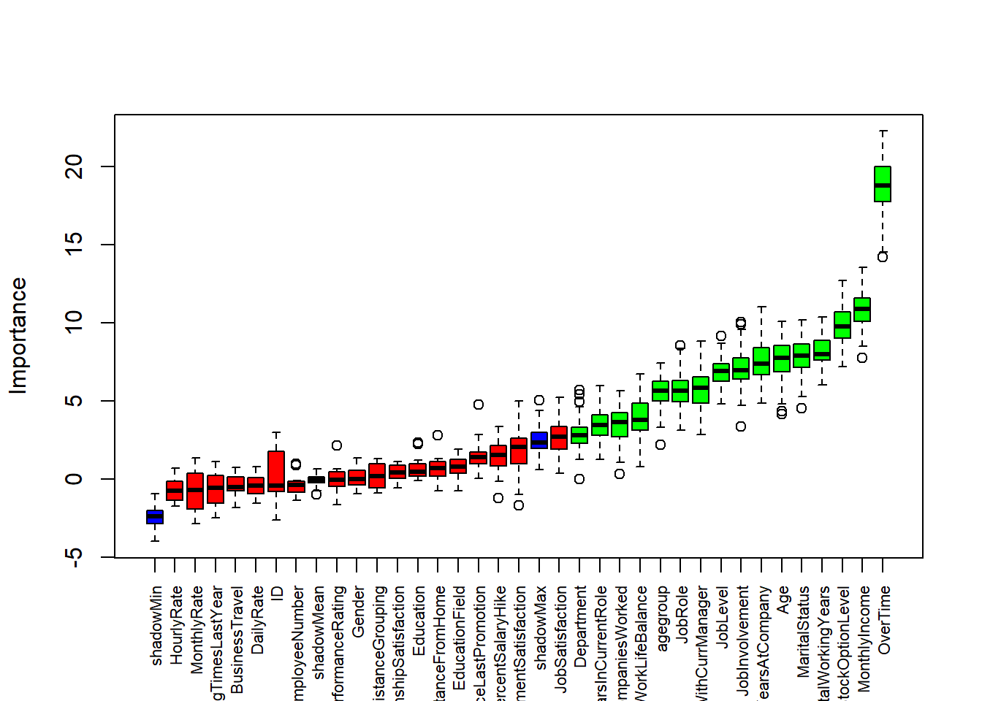
Attrition Factors
Boruta Feature Selection
Captures important features
Duplicates the dataset, shuffles values
Iterates and checks z scores
Z score is standard deviations from mean
Top 3 factors :
Overtime
Monthly Income
Stock Option Level

Slide 6
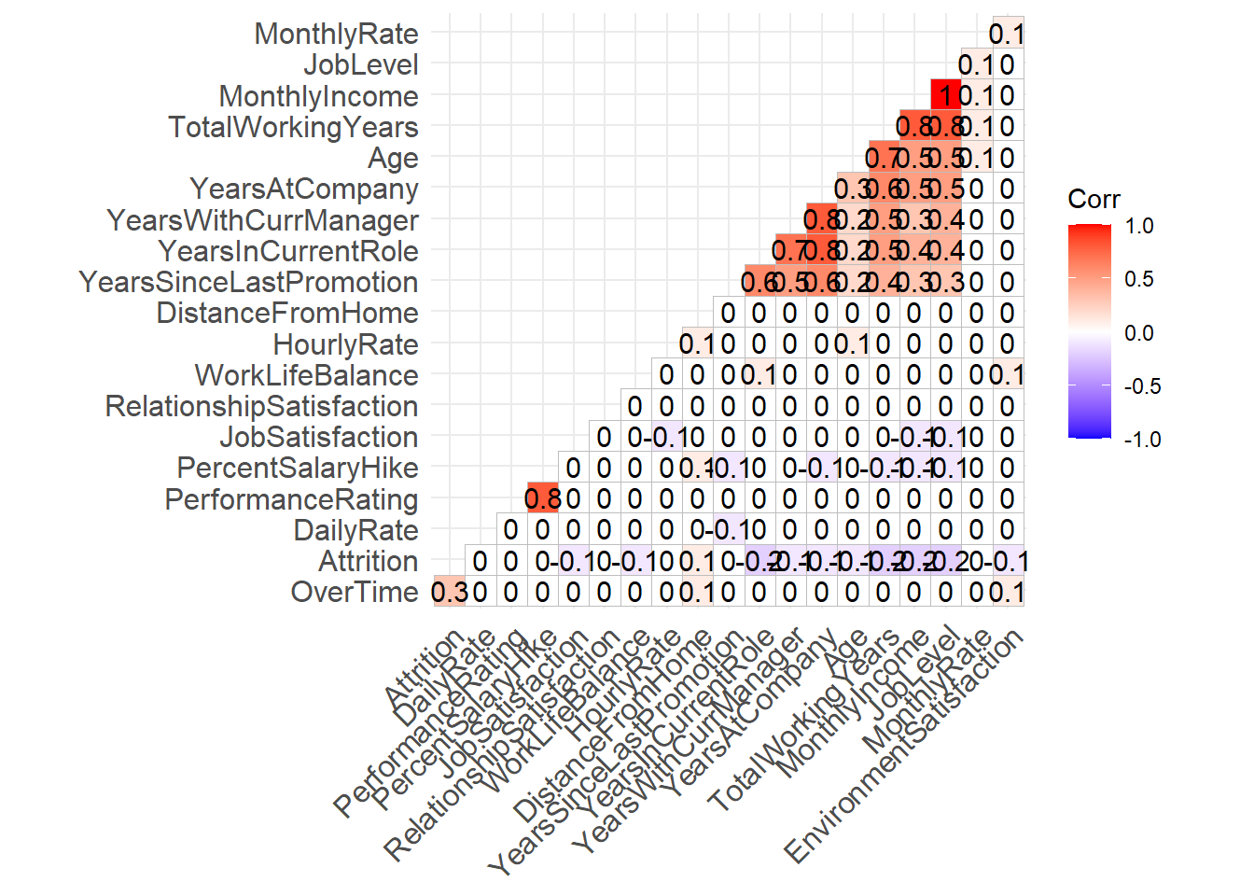
Correlation
Dropped variables with high correlation between each other
YearsAtCompany, TotalWorkingYears, JobLevel, PercentSalaryHike
Dropped variables with 0 variance
Over18, EmployeeCount, StandardHours
Basis for Attrition model
Salary model dropped values with high VIF
Age, DistanceFromHome, Department

Slide 7
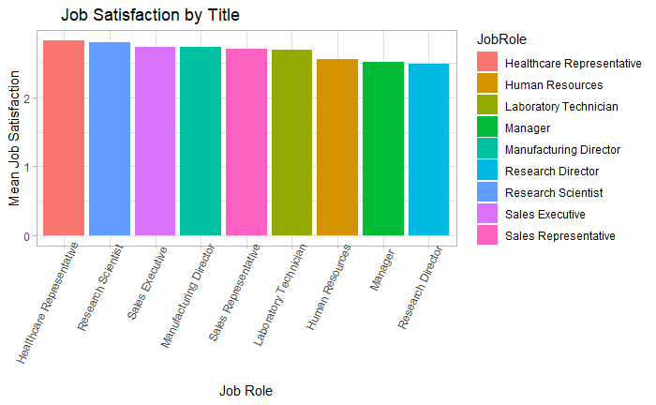
Interesting Trends in Data
Job Satisfaction by Title
HR Representative
Research Scientist
Sales Executive
Job Satisfaction by Dept
HR
Sales
Research
Senior Leadership

Slide 8
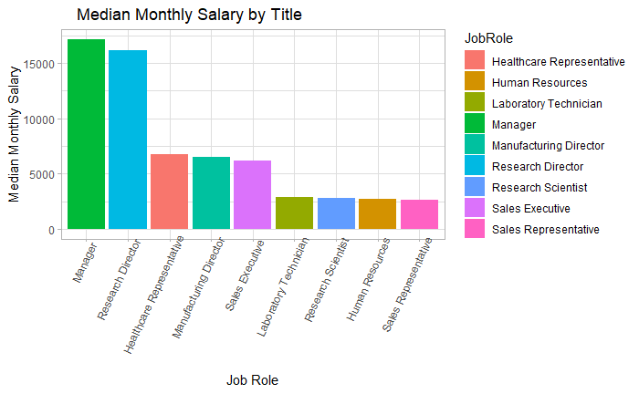
Interesting Trends in Data
Median Monthly Salary by Title
Manager
Research Director
HR Rep

Slide 9
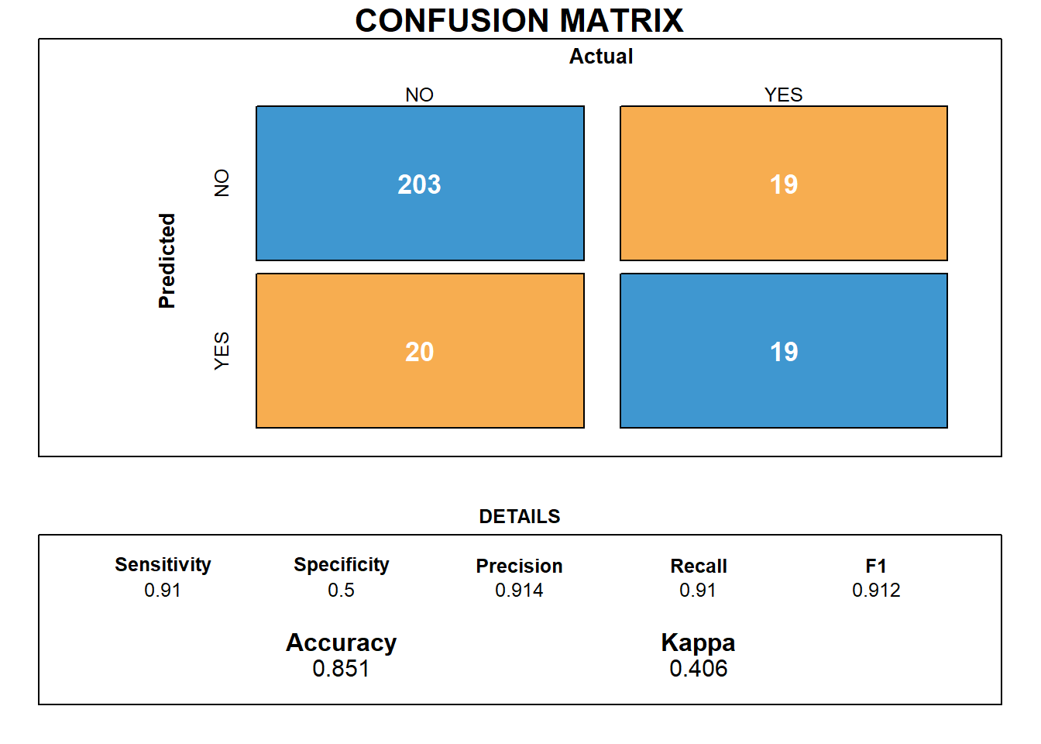
Attrition Model
Naïve Bayes
Calculate prior probability for given class
Find likelihood probability for each attribute
Put values in Bayes
Calculate Posterior probability
See which class has higher probability

Slide 10
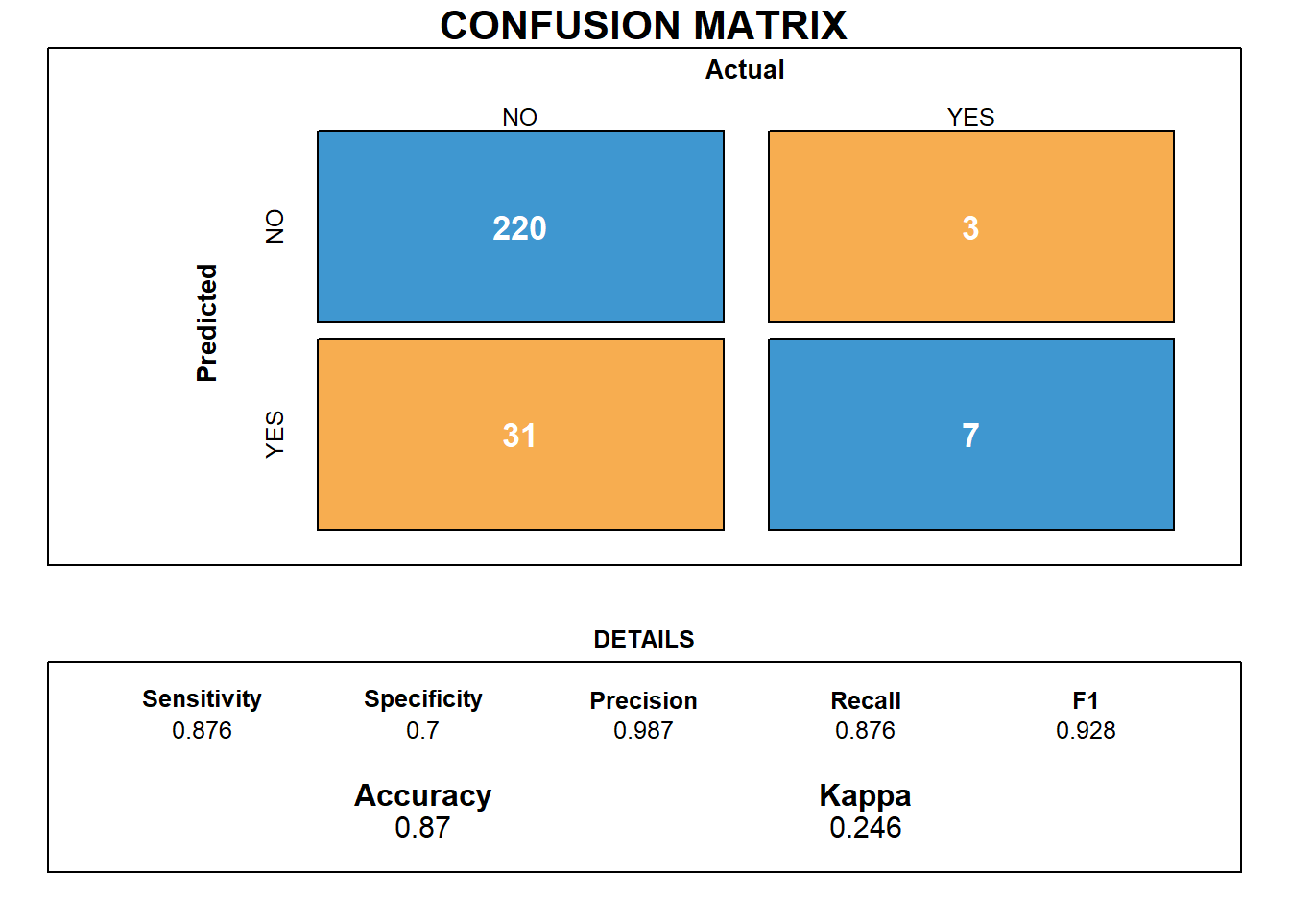
Attrition Model
Random Forest
Select Random samples from Attrition
Construct Decision Tree for each sample
Prediction result from each decision
Perform a vote for each predicted result
Select Prediction result with most votes

Slide 11
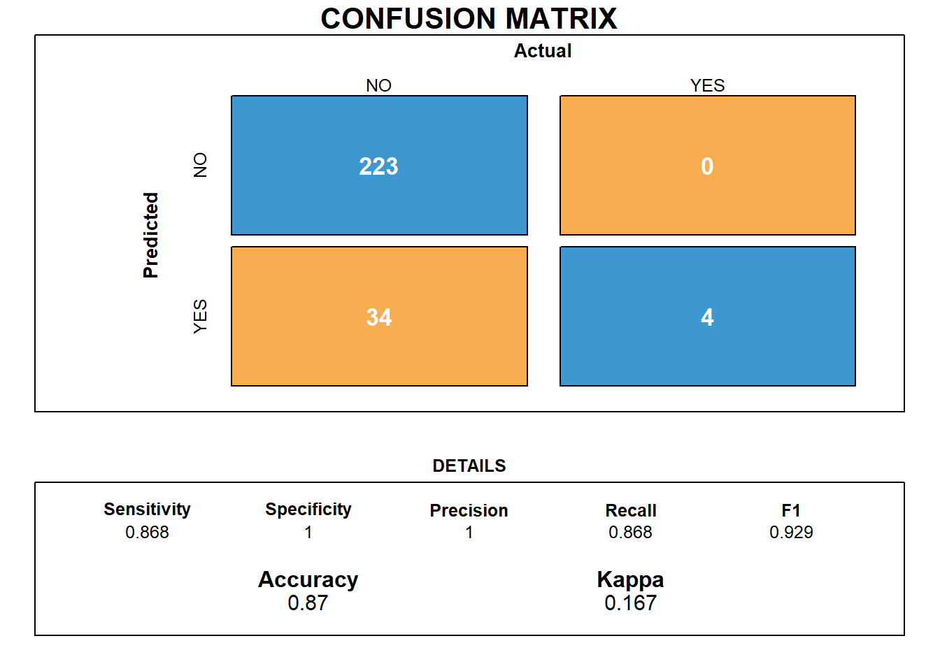
Attrition Model
Support Vector Machine Model
Find hyperplane in N-dimensional space
N = number of features
Hyperplane = decision boundary that classifies data point
Support vector
Data point closer to the hyperplane
Overfitting

Slide 12
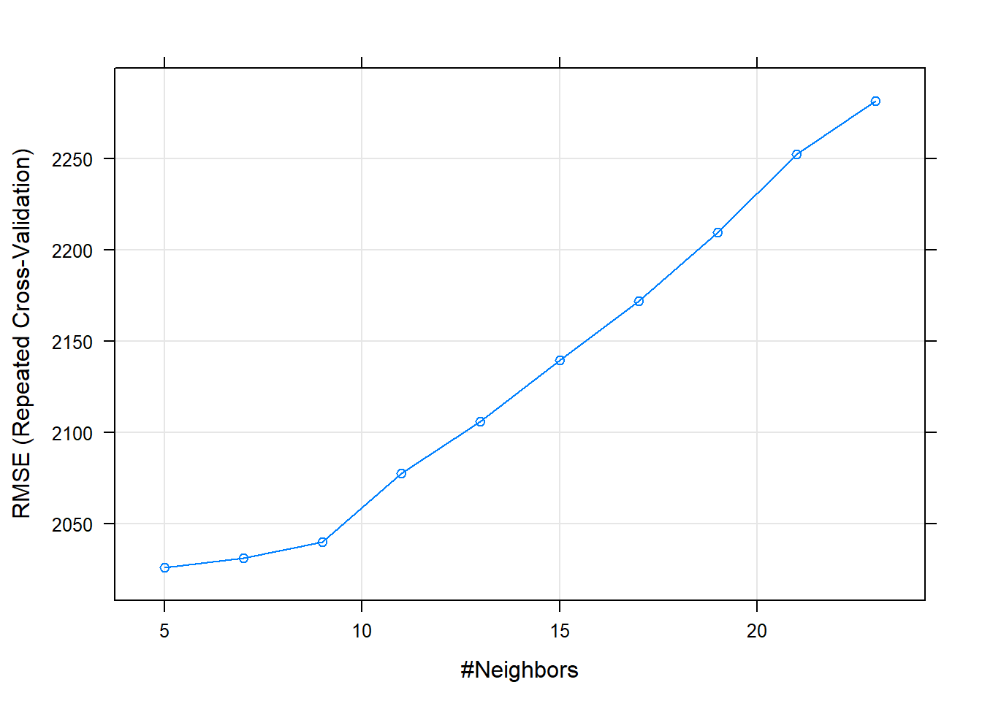
Salary Model
KNN
Calculate distance
Find nearest neighbors
Vote on label
K = 5 optimal
$2025 RMSE

Slide 13
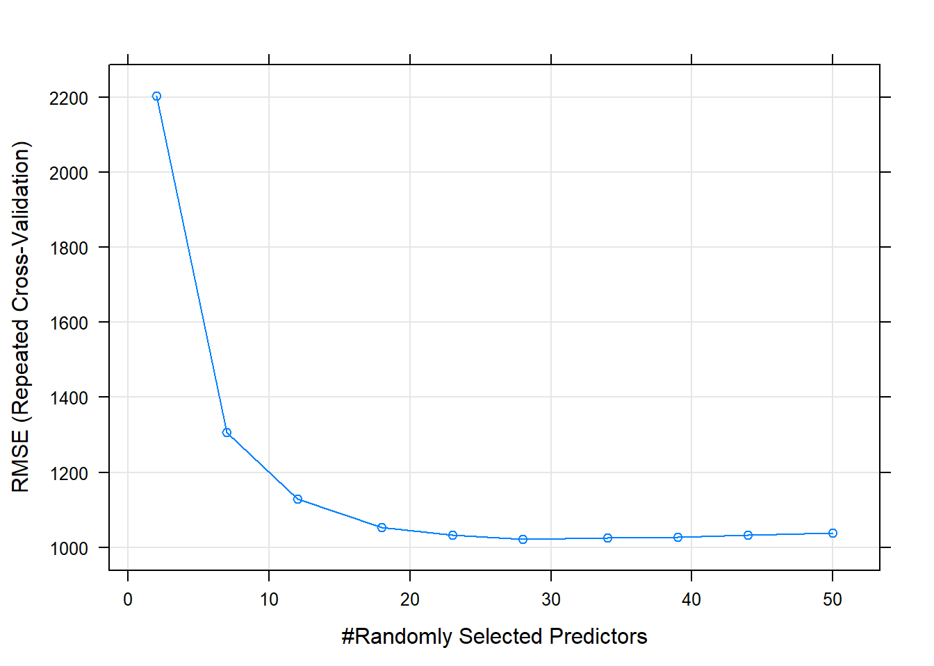
Salary Model
Random Forest
22 Selected Predictor
Repeated CV
$1050 RMSE

Slide 14
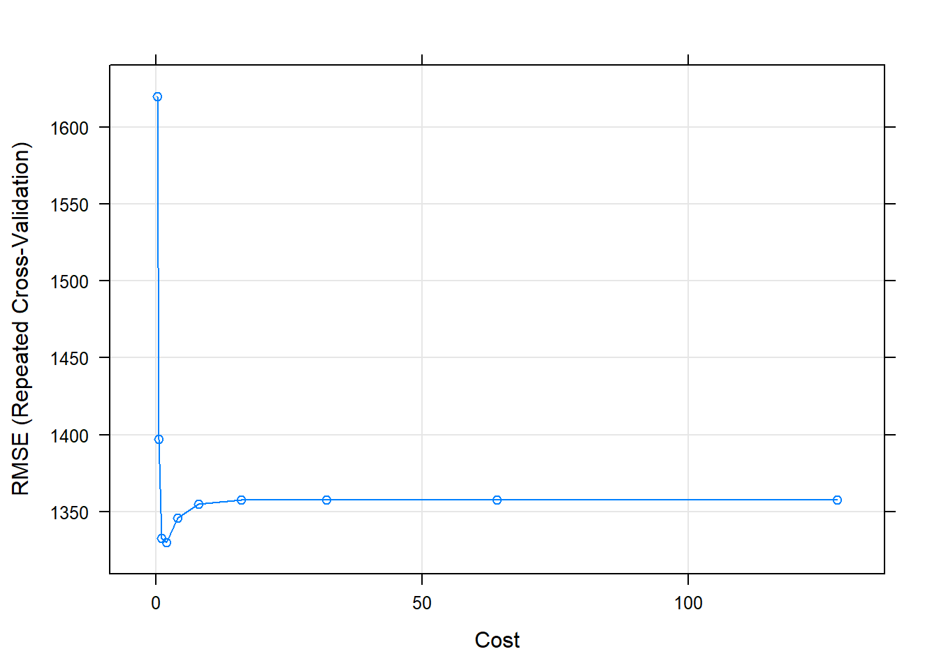
Salary Model
SVN Model
Cost plateaued
RMSE - $1300

Slide 15
Conclusion
Random Forest Model best for both model predictor and classifiers
Based on trees so scaling variables doesn’t matter
Deals with missing data not needed here
Automated feature selection built in
Other than Stock Options, Monthly Income, and Overtime
Age, Total Working Years and Marital Status strong factors for attrition

